Slide 1
Index
1) Realsense D435i
  D435i setup
  Visualization
  Data for Accelerometer and Gyroscope
  RGBD data
  Object Detection
  Person Height Detection
  Object Classification
  Tracking of an Object
2) Motion Prediction
  Motion Prediction of an Object(following the equation of motion)
3) Point Cloud
  Point Cloud Visualization
4) Robotics
  ROS2

Slide 2
1) Realsense D435i

Slide 3
Prerequisites
Note: We are supporting Ubuntu 18/20/22 LTS versions.
Note: The scripts and commands below invoke wget, git, add-apt-repository which may be blocked by router settings or a firewall.
Infrequently, apt-get mirrors or repositories may also cause timeout. For librealsense users behind an enterprise firewall, configuring the system-wide Ubuntu proxy generally resolves most timeout issues.
Important: Running RealSense Depth Cameras on Linux requires patching and inserting modified kernel drivers.

Slide 4
D435i setup
Download Intel.RealSense.Viewer.exe and then open it and connect D435i camera to your PC
For setup on Linux follow the link: https://github.com/IntelRealSense/librealsense/blob/master/doc/distribution_linux.md
(Refer to the installation for Linux)
After downloading the required packages, run the below command in terminal:
realsense-viewer

Slide 5
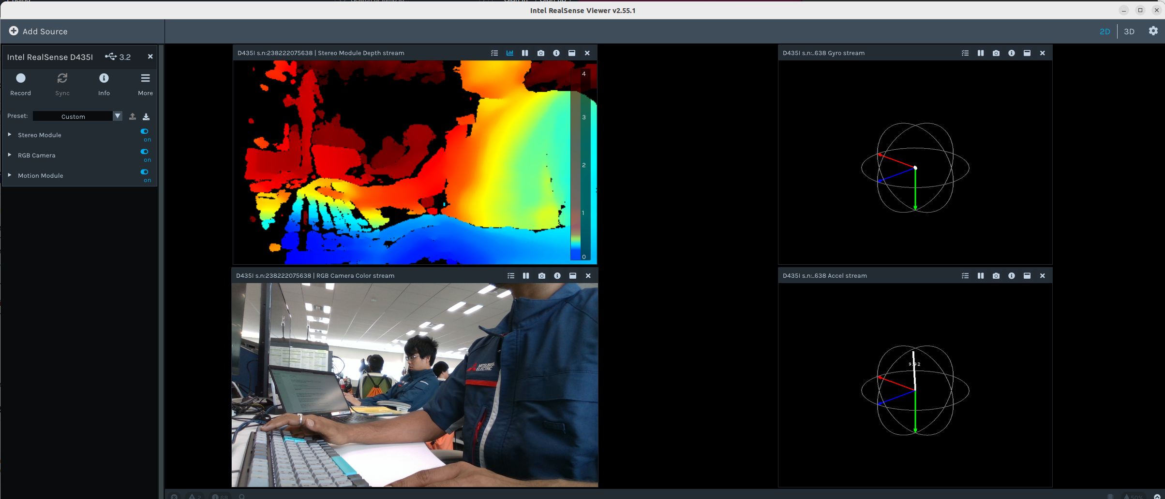

Slide 6
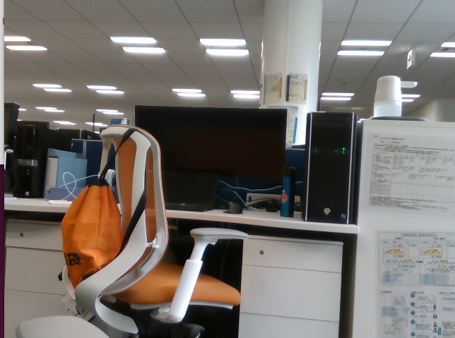
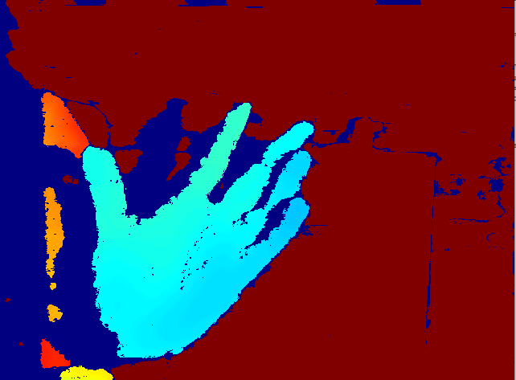
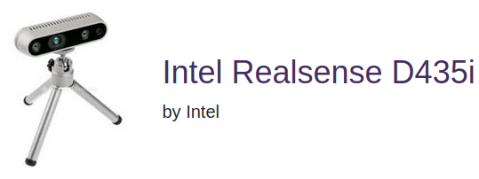
Visualization
In Ubuntu 22.04, in Documentation directory (on desktop) run D435i.py file to get RGB and depth real-time image.
Use of pyrealsense2 library: Python wrapper for the Intel RealSense SDK
cv2 library: for the computer vision task
numpy library: for numerical computation especially for array

Slide 7
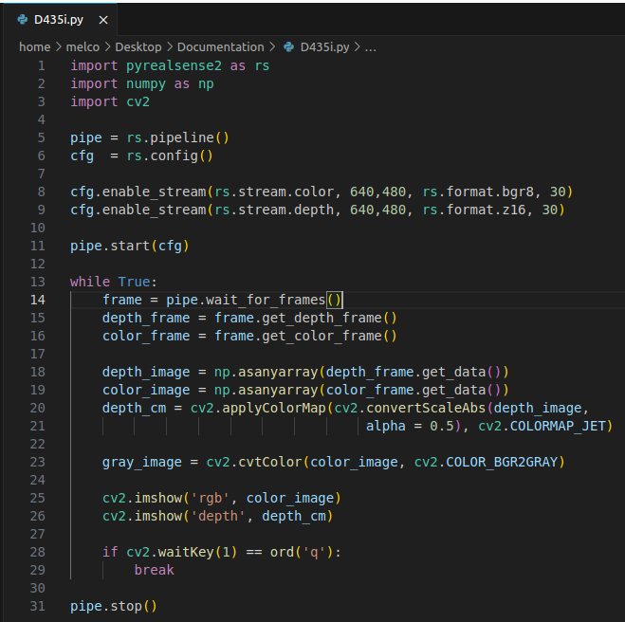

Slide 8
Setting up RealSense Pipeline:
pipe = rs.pipeline(): This creates a RealSense pipeline object.
cfg = rs.config(): This creates a configuration object for the pipeline.
Configuring Streams:
cfg.enable_stream(rs.stream.color, 640, 480, rs.format.bgr8, 30): This configures the pipeline to enable the color stream with a resolution of 640x480 pixels, using the BGR8 (Blue, Green, Red 8-bit) format, and a frame rate of 30 frames per second.
cfg.enable_stream(rs.stream.depth, 640, 480, rs.format.z16, 30): This configures the pipeline to enable the depth stream with the same resolution, using the 16-bit format (z16), and a frame rate of 30 frames per second.
Starting the Pipeline:
pipe.start(cfg): This starts the pipeline with the configured settings.
Capturing Frames in a Loop:
while True:: This creates an infinite loop for continuously capturing frames.
frame = pipe.wait_for_frames(): This captures a frame from the RealSense camera.
depth_frame = frame.get_depth_frame(): This retrieves the depth frame from the captured frame.
color_frame = frame.get_color_frame(): This retrieves the color frame from the captured frame.
Converting Frames to Numpy Arrays:
depth_image = np.asanyarray(depth_frame.get_data()): This converts the depth frame to a NumPy array.
color_image = np.asanyarray(color_frame.get_data()): This converts the color frame to a NumPy array.
Visualizing Depth Image:
depth_cm = cv2.applyColorMap(cv2.convertScaleAbs(depth_image, alpha=0.5), cv2.COLORMAP_JET): This applies a colormap (jet) to the depth image, converting it to a colored representation. The convertScaleAbs function scales the depth values and converts them to absolute values.
Converting Color Image to Grayscale:
gray_image = cv2.cvtColor(color_image, cv2.COLOR_BGR2GRAY): This converts the color image to grayscale using OpenCV's cvtColor function.
Displaying Images:
cv2.imshow('rgb', color_image): This displays the color image in a window titled 'rgb'.
cv2.imshow('depth', depth_cm): This displays the depth image in a window titled 'depth'.
Exiting the Loop:
if cv2.waitKey(1) == ord('q'):: This waits for a key press and checks if the pressed key is 'q'. If 'q' is pressed, the loop breaks, and the program exits.
Stopping the Pipeline:
pipe.stop(): This stops the RealSense pipeline, releasing the resources.

Slide 9
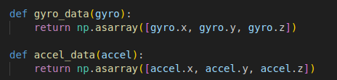

Data for accelerometer & Gyroscope
In Ubuntu 22.04, in Documentation directory (on desktop) run Gyro_acce_data.py file to get accelerometer and gyroscope data.
The data collected is stored in ‘sensor_data.txt’ in Home

Slide 10
RGBD data
In Ubuntu 22.04, in Documentation directory (on desktop) run RGBDdata.ipynb file
Reference: https://github.com/IntelRealSense/librealsense/blob/master/wrappers/python/examples/opencv_viewer_example.py
Saves the RGBD data in RGBDdata.txt file for further use
Purpose: RGBD data enables the creation of accurate 3D models of scenes or objects
Applications:
  Virtual Reality(VR) and Augmented Reality (AR)
  Digital Twin Creation
  Architecture Visualization
  Object Recognition & Segmentation

Slide 11
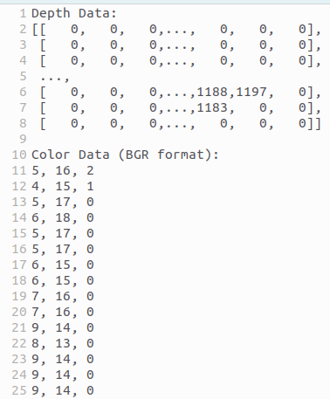
Depth Data:
→ Each frame's depth data is stored in the text file under the section labeled "Depth Data:"
→ The depth data is converted into a string representation using np.array2string(depth_image, separator=','). This function converts the depth image (which is a numpy array) into a string where each pixel value is separated by a comma.
Color Data:
→ Each frame's color data in BGR format is stored under "Color Data (BGR format):"
→ The script iterates through each pixel in the color image (color_image) and writes each pixel's BGR values (separated by commas) to the file.

Slide 12
Object Detection
In Ubuntu 22.04, in Documentation directory (on desktop) run Object_Detection.ipynb to detect the object in real-time
This Python script utilizes Intel's RealSense camera along with TensorFlow's object detection API to perform real-time object detection and bounding box visualization.
Download frozen_inference_graph.pb →serialized TensorFlow graph that has been frozen, meaning that the graph’s variables have been converted into constants.
Download faster_rcnn_inception_v2_coco_2018_01_28.pbtxt →deep learning-based object detection algorithm introduced by Shaoqing Ren, Kaiming He, Ross Girshick, and Jian Sun in 2015.
“ Faster R-CNN has become one of the standard approaches for object detection due to its balance between speed and accuracy. It has been widely adopted in various applications, including autonomous driving, surveillance, and image analysis ”

Slide 14
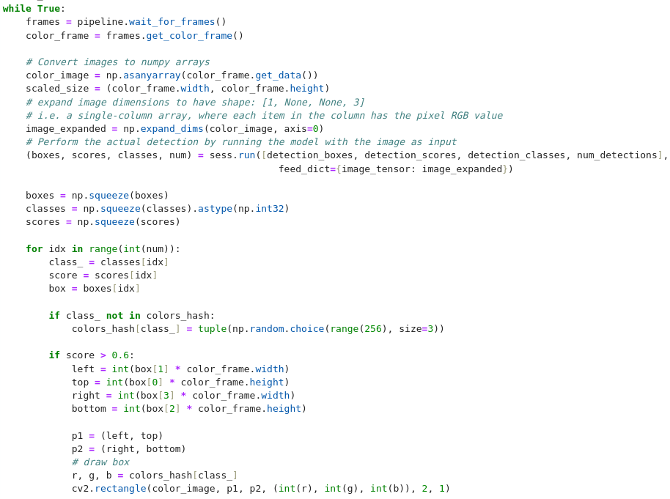
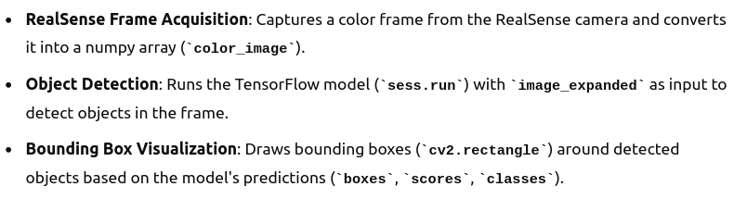

Slide 15
Imports: The necessary libraries/modules are imported: pyrealsense2 for RealSense camera, numpy for array manipulation, cv2 for computer vision tasks, and tensorflow for deep learning.
Pipeline Configuration: RealSense pipeline is configured to enable color streaming with specific resolution and format.
Model Loading: A pre-trained TensorFlow object detection model (frozen graph) is loaded into memory. The model is loaded using TensorFlow's GraphDef and Session.
Tensor Definitions: Input and output tensors are defined for the TensorFlow model, specifying where the image should be fed in and where the output predictions can be obtained.
Main Loop:
The script enters an infinite loop for continuous processing. It waits for frames from the RealSense camera. Extracts the color frame and converts it into a numpy array.
Reshapes the image array for TensorFlow model input and performs object detection.
Processes the detection results:
Filters detections based on a confidence threshold (0.6 in this case).
Draws bounding boxes around detected objects on the color image.
Assigns random colors to different object classes.
Displays the processed image with bounding boxes in a window.
Loop continues until interrupted.
Cleanup: When the loop is exited (by interrupting the script), the RealSense pipeline is stopped.

Slide 16
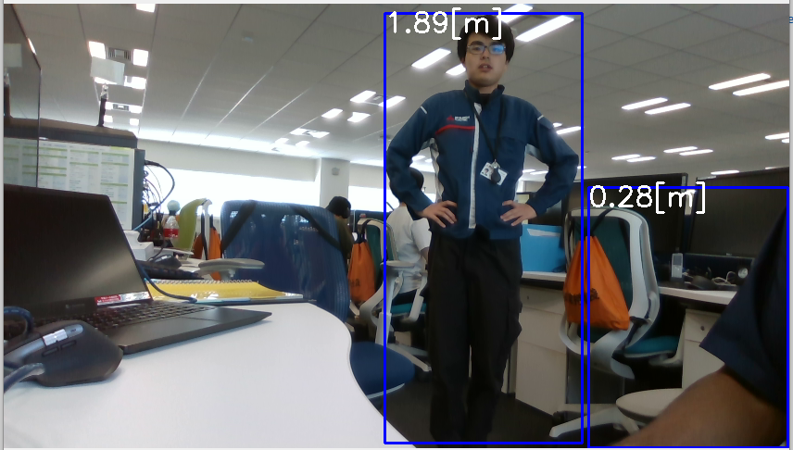
Person Height Detection
In Ubuntu 22.04, in Documentation directory (on desktop) run personHeight.ipynb to detect the person’s height in real-time

Slide 17
Object Classification
In Ubuntu 22.04, in Classification using MaskRCNN directory (on desktop) run main.ipynb to classify the object in real-time
We can classify 81 objects. All the objects that can be classified is in classes.txt file.
A real-time system for object detection and depth information visualization using a Realsense camera and the Mask R-CNN model.
It combines computer vision techniques with deep learning for object detection and utilizes depth data for additional insights into the detected objects.
Reference: https://arxiv.org/pdf/1811.04535

Slide 19
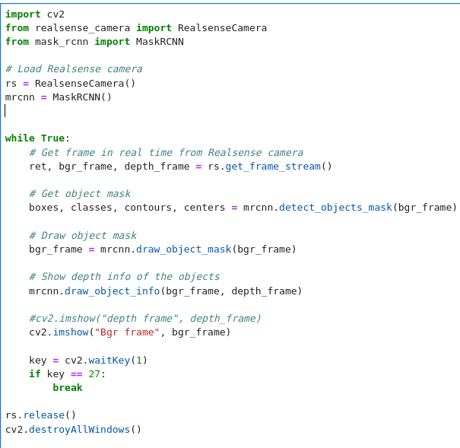
Initializes an instance (mrcnn) of the MaskRCNN class, which likely loads a trained Mask R-CNN model and provides methods for detecting objects (detect_objects_mask), drawing object masks (draw_object_mask), and displaying depth information (draw_object_info).

Slide 20
Tracking of an Object
1) Manual bounding box tracking
  In Ubuntu 22.04, in tracking directory (on desktop) run opencv_object_tracker.ipynb to track the object in real-time
  This file tracks the bounded object done manually. It uses CSRT algorithm.
  After running the file, the tracked data (x1, y1, x2, y2, z) → (coordinate of upper left corner, bottom right corner and depth from camera) is stored in tracked_data.txt
  We have to build the bounding box manually.

Slide 22


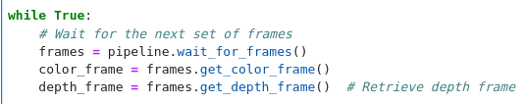
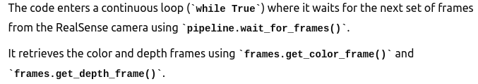
Creates an object tracker using the CSRT (Channel and Spatial Reliability Tracker) algorithm provided by OpenCV.
Tracked_data will store all the tracked data

Slide 23
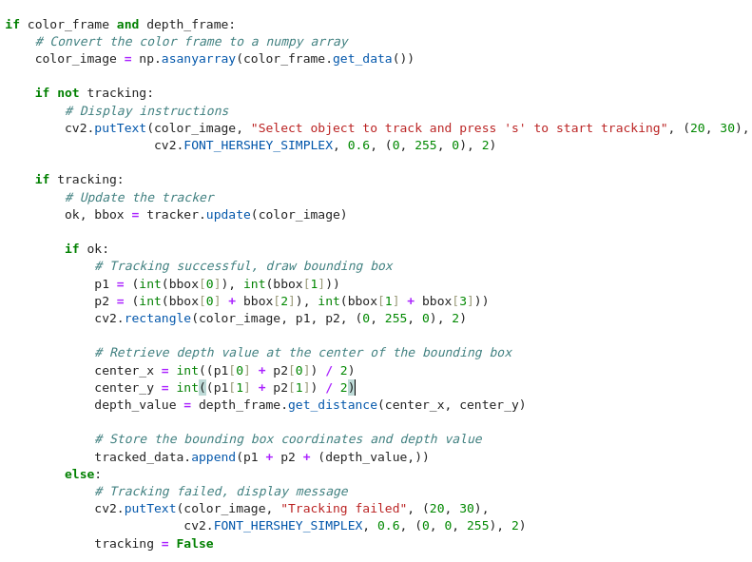

Slide 24
Tracking of an Object
2) In the same directory run MultipleManual.ipynb file to track multiple object bounded manually.
  Also uses tracks the bounded object done manually. It uses CSRT algorithm.
  After running the file, the tracked data (x1, y1, x2, y2, z) → (coordinate of upper left corner, bottom right corner and depth from camera) is stored in tracked_data.txt
  We have to build the bounding box manually.

Slide 26

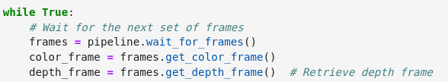
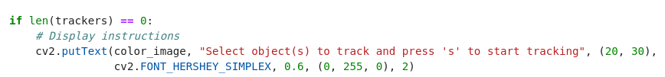
Lists to store multiple object trackers (trackers) and corresponding tracked data (tracked_data).
Continuously waits for the next set of frames from the RealSense camera.
Converts the color frame data to a numpy array (`color_image`) for processing with OpenCV.

Slide 27

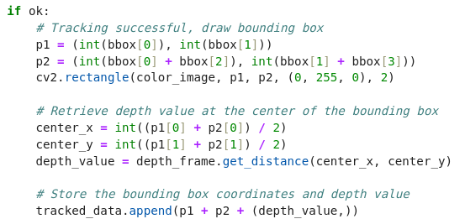
Iterates over existing trackers (`trackers`) to update each tracker with the current frame (`color_image`).
If tracking is successful (`ok` is True), it draws a bounding box around the tracked object (`cv2.rectangle`),
calculates the center of the bounding box, retrieves the depth value from the depth frame at that center, and
stores the bounding box coordinates and depth value in `tracked_data`.

Slide 28
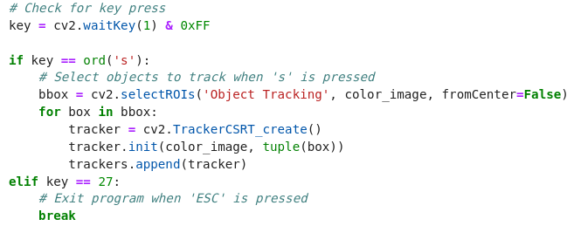
Handles key presses:
- Pressing 's' allows the user to select ROIs (regions of interest) to track using `cv2.selectROIs`. For each selected ROI, a CSRT (Discriminative Correlation Filter with Channel and Spatial Reliability) tracker is created and initialized.
- Pressing 'ESC' (key 27) breaks out of the main loop, terminating the program.

Slide 29
Tracking of an Object
3) In the same directory run MultipleAuto.ipynb file to track multiple object bounded Automatically.
  Makes the bounding box automatically. This python script integrates object detection using YOLO with object tracking using OpenCV and Intel RealSense Camera.
  Tracks 80 object listed in the coco.names file.
  Slow on CPU
  GPU Acceleration: Speed of the tracking can be increased with compatible GPU drivers and CUDA toolkit.

Slide 31
2) Motion Prediction

Slide 32
Motion Prediction of an Object following equation of motion
We are predicting the motion of an object(balls) in each frame of the video. The script starts by detecting object (balls) in each frame using the Hough circle Transform.
When the current position of the ball is located, the Kalman filter is initiated with a measurement matrix (kf.measurementMatrix) that maps the observed position (x, y coordinates) to the state vector.
The transition matrix (kf.transitionMatrix) predicts the next state based on the current state and assumes a constant velocity motion model.
Once a ball's position is detected (coords), the Estimate method of the Kalman filter is called. This method takes the current observed position (coordX, coordY) as input, predicts the next position using the Kalman filter’s predict method, and corrects the prediction using the observed measurement with correct.

Slide 33
3) Point Cloud

Slide 34
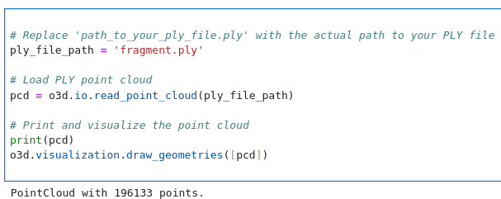
Open3D
Open-source library that supports rapid development of software that deals with 3D data.
Documentation: https://www.open3d.org/docs/release/
Visualize point cloud:

Slide 37
4) Robotics (ROS2)

Slide 38
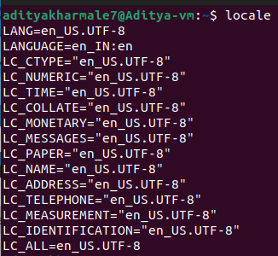
Installation
Debian packages for ROS 2 Humble Hawksbill are currently available for Ubuntu Jammy (22.04): https://docs.ros.org/en/humble/Installation/Ubuntu-Install-Debians.html
Step 1) Set Locale
  Make sure you have a locale which supports UTF-8
  Follow the below command’s:
  locale # check for UTF-8
  sudo apt update && sudo apt install locales
  sudo locale-gen en_US en_US.UTF-8
  sudo update-locale LC_ALL=en_US.UTF-8 LANG=en_US.UTF-8
  export LANG=en_US.UTF-8
  locale # verify settings

Slide 39
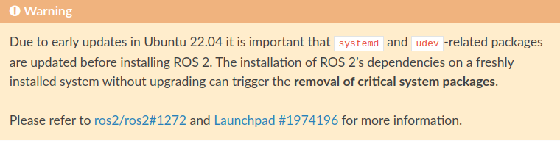
Step 2) Setup Resources
  $ sudo apt install software-properties-common
  $ sudo add-apt-repository universe
  $ sudo apt update && sudo apt install curl -y
  $ sudo curl -sSL https://raw.githubusercontent.com/ros/rosdistro/master/ros.key -o /usr/share/keyrings/ros-archive-keyring.gpg
  $ echo "deb [arch=$(dpkg --print-architecture) signed-by=/usr/share/keyrings/ros-archive-keyring.gpg] http://packages.ros.org/ros2/ubuntu $(. /etc/os-release && echo $UBUNTU_CODENAME) main" | sudo tee /etc/apt/sources.list.d/ros2.list > /dev/null
Step 3) Install ROS2 packages
  $ sudo apt update
  $ sudo apt upgrade

Slide 40
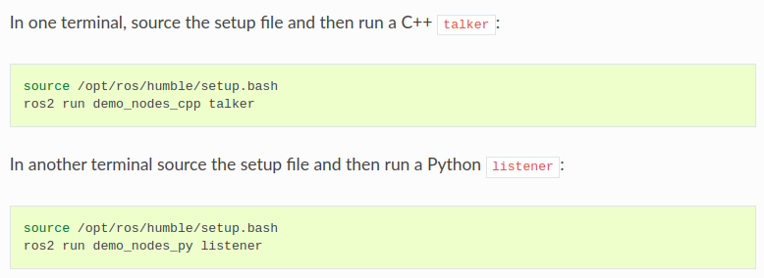
Points to be mentioned
Add “source /opt/ros/humble/setup.bash” at the end of the script by opening
$ gedit ~/.bashrc

Slide 41
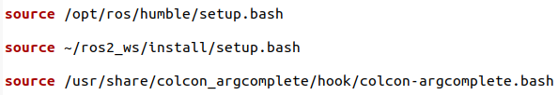
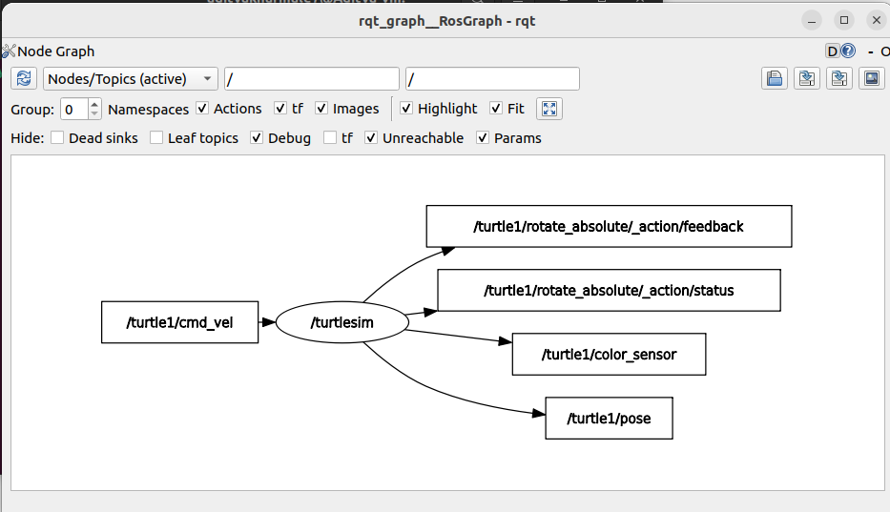
*Add the above as it is in .bashrc
Some Important command on ROS2
$ rqt_graph → Shows the GUI for the actions that are going

Slide 42
$ ros2 run turtlesim turtlesim_node → GUI for turtle
$ ros2 run turtlesim turtle_teleop_key → to control the turtle using key
$ colcon build –symlink-install → After building the node, execute this command to build colcon workspace
$ source ~/.bashrc
$ ros2 run <package_name> <node_executable> → To run a specific node
$ ros2 node list → Provide a list of all active ROS2 nodes currently available in the ROS2 system
$ ros2 topic list → Provide a list of all active ROS2 topics currently available in the ROS2 system
$ ros2 pkg create <name_of_package> --build-type ament-python –dependencies rclpy → when we create a workspace, it’s important to specify it’s build type and dependencies
$ chmod +x my_first_node.py → To make a node executable

Slide 43
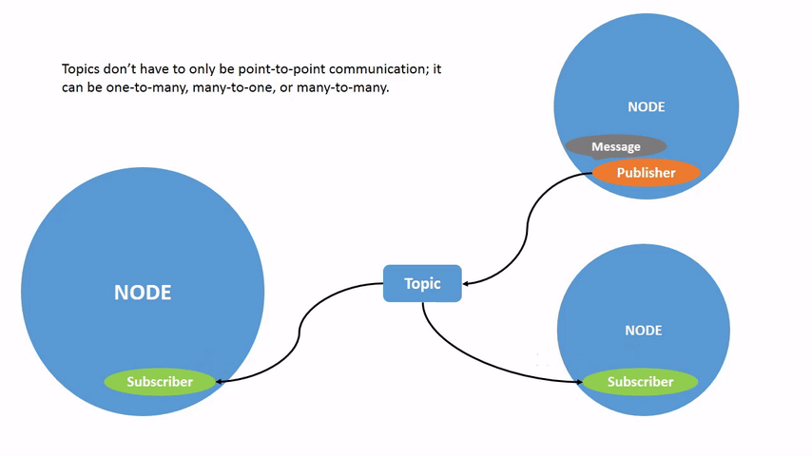

Slide 44
Why ROS2?
Modularity and Flexibility: Modular architecture allows for scalable and reusable code, supporting diverse robotic applications.
Real-time Capabilities: Improved support for real-time and embedded systems, crucial for precise timing in industrial automation and autonomous vehicles.
Security: Built-in features for secure communication and resource management, ensuring data integrity and protection.
Active Community and Ecosystem: Large community support with extensive libraries, tools, and packages, accelerating development and innovation.
Tooling and Development Workflow: Enhanced tools for debugging, simulation, and integration with modern development environments, streamlining development processes.
Industry Adoption: Increasingly adopted in industries like manufacturing, healthcare, and agriculture for its robustness and flexibility.
Compatibility and Standardization: Backward compatibility with ROS 1 and ongoing standardization efforts ensure interoperability and future-proofing of robotic systems.

